Slide 1
CG2111A
Week 9 – Studio 2
TCP/IP + TLS

Slide 2
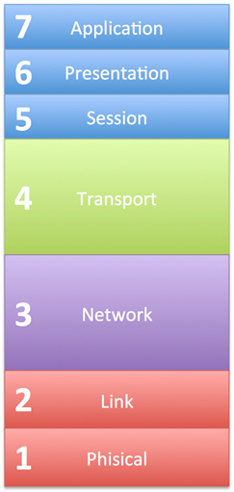
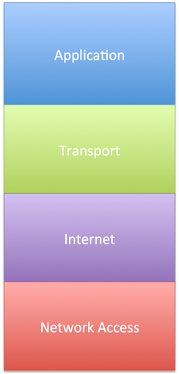
TCP / IP vs 7-Layer
Process-to-process data transfer
Routing of datagrams from host to host
OSI 7-Layer Model
TCP/IP Model
data transfer between neighbouring network elements
bits on the transmission media

Slide 3

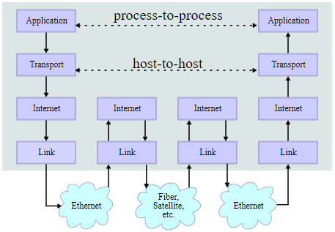
TCP / IP : In Action
Source: Partially from Wikipedia

Slide 4
TCP – Transmission Control Protocol
IP is a “best effort” protocol
Additional check and controls are needed for reliable end-to-end communication
TCP ensures:
Packets are sent and acknowledged
Packets are reassembled in correct order
A “connection” is established between the sender / receiver
Etc……

Slide 5
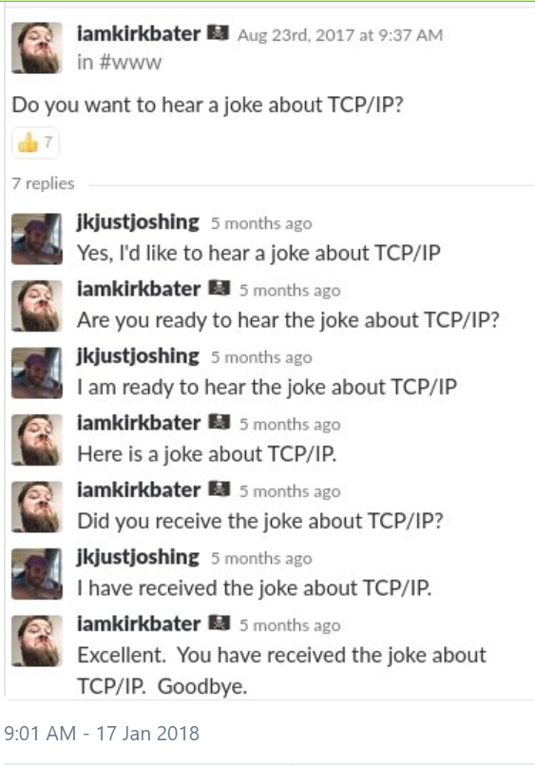

Slide 6
Socket Programming
An API built on TCP/IP
Socket
Socket
Port
Port
Transport
Transport
Server
Client
Internet
Internet
Network Access
Network Access

Slide 7
So……
Vincent-server.cpp
Vincent-client.cpp
Port
Port
Transport
Transport
Server (Alex’s PI)
Client (Your Laptop)
Internet
Internet
Network Access
Network Access

Slide 8
Transport Layer Security

Slide 9
The General Idea
Encryption Process consists of:
Plaintext
Algorithm
Key
Text (Information) to be encrypted
A series of steps used to encrypt the text
Special information used by the algorithm for encryption
Only holder of key can decrypt the information later

Slide 10



Encryption Process: Illustration
I love you
Key
Plaintext
Encryption
Algorithm
k nqxf aqw
Ciphertext

Slide 11
Decryption Process: Illustration
k nqxf aqw
Key
Ciphertext
Encryption
Algorithm
I love you
Plaintext

Slide 12
The problem of key distribution
Distribution of key is still the weakest link
To securely send information by encryption, you need to first tell recipient about the key in secured way
In the age of Internet, this is even more important!
Need to send information through an unsecured medium
Solving the key distribution problem is the most significant breakthrough in encryption

Slide 13
The key distribution problem: Illustration
Bob, the key is “computing”
Alice
Bob
Aha! Got you!
Eve
Scenario:
Alice and Bob need to communication securely
Eve is trying to eavesdrop
There is no way for Alice and Bob to agree on an encryption key without Eve knowing

Slide 14
Some background
Key to encrypt and decrypt is the same
known as symmetric key encryption
hence the key cannot be compromised
The breakthrough discovery: asymmetrical key encryption
Use different keys to encrypt and decrypt
Public Key Encryption is one such example
Uses public key to encrypt
Uses private key to decrypt

Slide 15
Public Key Encryption: Basic Idea
The public key and private key must be related mathematically
It should be hard to deduce the private key from public key
Public key is widely publicized
used to encrypt message only
cannot decrypt encrypted message
Private key should be kept secret
used to decrypt message only

Slide 16
Public Key Encryption: Illustration
Bob, my public key is “CEG”
ok
Alice
Bob
private key = rocks
ok
Eve
KXWYALO…
Alice
Bob
private key = rocks
argh! cannot decrypt using “CEG”
Eve

Slide 17
Public and Private Key: Is it possible?
The idea of public key encryption is suggested before anyone know how to find such keys
Many consider such thing to be impossible
Two teams eventually solve the problem:
James Ellis, Clifford Cocks and Malcolm Williamson (1975)
Government Communications Headquarters (England)
Ronald Rivest, Adi Shamir and Leonard Adleman (1978)
Massachusetts Institute of Technology (USA)
The algorithm is known as RSA after the 2nd team
Why not the 1st team?

Slide 18
Public and Private Key: Basic Idea
Instead of covering the full algorithm, we show the basic idea behind the generation of public and private key
To generate a public key:
Choose two prime numbers p and q
Calculate N = p x q
N is the public key, while p and q form the private key
Given N, it is very hard to discover the p and q
i.e. through the process of factorization

Slide 19
Factorization: Is it hard?
At first look, it seems easy to deduce p and q from N
Try the following:
N = 143 p = _______ q = __________
N = 8633 p = _______ q = __________
N = 175, 828, 273 p = _______ q = __________
In actual usage, N is typically in the range of 2¹⁰²⁴
Remember, RSA is not unbreakable, just “unbreakable in reasonable time” ☺

Slide 20
Diffie-Hellman-Merkle Key Exchange
One use of the public-private key idea is:
Exchange a symmetric key for both party to use
Once key is successfully exchanged, normal symmetric encryption/decryption can be used

Slide 21
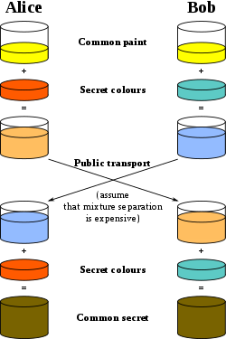
Diffie-Hellman-Merkle Key Exchange

Slide 22
Are you Alice?
Bob, my public key is “computing”
I’m so confused!
Alice
Bob
Bob, I am the real Alice, my public key is “fun”
Eve

Slide 23
Check my signature
encrypt_{public_key}( M ) ➔ N
decrypt_{private_key}( N ) ➔ M
Reverse is also true!
encrypt_{private_key} ( M ) ➔ N
decrypt_{public_key} ( N ) ➔ M

Slide 24
Are you Alice - Solution
Bob, my public key is “computing”
Alice my public key is “engineering”
private key = rocks
private key = funz
Alice
Bob
Digest_{A}
Message M
Message M
Digest_{A}
Message M
Digest_{A}
Digest_{A}
Message M
Digest_{B}
Digest_{A}
Digest_{A}

Slide 25
Are you Alice - Is it really solved?
Bob, my public key is “computing”
Alice my public key is “engineering”
private key = rocks
private key = funz
Alice
Bob
Digest_{A}
Message M
Message M
Digest_{A}
Message M
Digest_{A}
Digest_{A}
Message M
Digest_{B}
Digest_{A}
Digest_{A}

Slide 26
Introducing Charlie
Bob, my public key is “computing”
Alice my public key is “engineering”
private key = rocks
private key = funz
Alice
Bob
Digest
PublicKey_{A}
Digest
PublicKey_{A}
Everyone, my public key is “trustworthy”
Charlie
private key = soconfused

Slide 27
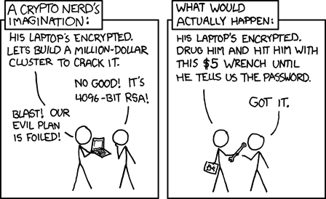

Slide 28
W10S1 – In a nutshell
signing.key
signing.pem
X.crt
_{(Certificate)}
Cert. Signing Authority
X.csr _{(Certificate Request)}
Digest
signing.key
_{(public key)}
A1
signing.pem
Operator Laptop
Alex's Pi
laptop.key
_{(Public Key)}
alex.key
_{(Public Key)}
A2.2.1
A2.1.1
laptop.csr
_{(Certificate Request)}
A3
(basic TLS)
alex.csr
_{(Certificate Request)}
laptop.crt
_{(Certificate)}
A4
(TLS+Ctrl)
alex.crt
_{(Certificate)}
A2.1.4
A2.1.4
signing.pem
signing.pem

Slide 29
Handout Updates
Step 1.1 Generating The CA Key
openssl genrsa –des3 –out signing.key 4096
tls-alex-server.cpp
Locate the line #define BAUD_RATE B57600 Change to: #define BAUD_RATE B9600

